Slide 1

Instagram User Analytics SQL Fundamentals

Slide 2
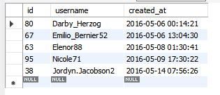
Find the 5 oldest users of the Instagram from the database provided
Select * from user order by created_at limit 5;
o/p :

Slide 3
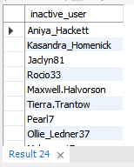
Find the users who have never posted a single photo on Instagram
Select usename as inactive_user from user left join photos on user.id=photos. user_id where photos. user_id is null;
o/p:

Slide 4
Identify the winner of the contest and provide their details to the team
SELECT users.username,photos.id,photos.image_url,COUNT(*) AS Total_Likes
FROM likes
JOIN photos ON photos.id = likes.photo_id
JOIN users ON users.id = likes.user_id
GROUP BY photos.id
ORDER BY Total_Likes DESC
LIMIT 1;

Slide 5
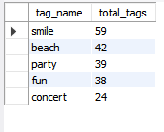
Identify and suggest the top 5 most commonly used hashtags on the platform
select tags.tag_name, count(*) as total_tags from photo_tags join tags on photo_tags.tag_id=tags.id group by tag_id order by total_tags desc limit 5;
o/p:

Slide 6
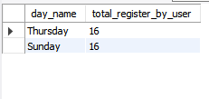
What day of the week do most users register on? Provide insights on when to schedule an ad campaign
SELECT DAYNAME(created_at) AS day_name,count(*) as total_register_by_user FROM users GROUP BY day_name ORDER BY total_register_by_user DESC LIMIT 2;
o/p:

Slide 7

Provide how many times does average user posts on Instagram. Also, provide the total number of photos on Instagram/total number of users
SELECT (SELECT COUNT(*) FROM photos) / (SELECT COUNT(*) FROM users) AS Avg ;

Slide 8
Provide data on users (bots) who have liked every single photo on the site (since any normal user would not be able to do this)
SELECT users.id,username, COUNT(users.id) As total_likes_by_user FROM users JOIN likes ON users.id = likes.user_id GROUP BY users.id HAVING total_likes_by_user = (SELECT COUNT(*) FROM photos);

Slide 9
Project Description
Operation Analytics is the complete end to end operations of a company.
Analyze the data of the company finds the areas on which it must improve upon.
this kind of analysis is further used to predict the overall growth or decline of a company’s fortune.

Slide 10
Approach
Get the information from given description about dataset and understand the problem.
Go through the row data and understand the attribute , variable that are given.
Use MySQL Workbench(8.0.32) create database and table then start writing my queries that are asked as question.
execute the queries and if there are any errors occurred then modified it without any errors.
done the assessment like that.

Slide 11
Tech-Stack Used
* MySQL workbench(version 8.0.32) is a open source SQL development, that helps me to create database and perform SQL operation .
* Microsoft word 2010 is allows to create various types of documentation and to prepare reports.

Slide 12
Insights
The knowledge that I gained from this project is how to create the database ,how to use the database , how can we perform SQL operation based on scenarios and how we can use the data to improve the business grow.

Slide 13
Result
I Have achieved how to analyze the project , by this project I gain more knowledge about SQL.

Slide 14
Thank you

